Slide 1

DATA 824 Product development Summer 2023
Charles Eggers

Slide 2

Topics
Background and Design
Data Source and Collection
Data Preparation
Data Visuals from Shiny App
Analysis and Insights
GitHub and Summary

Slide 3

Background and Design
Idea was to use Kansas Population and Crime data sets to do exploratory analysis to see any trends by county and year
This could lead to further review via predicative methods

Slide 4


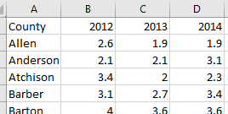
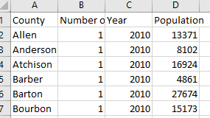
Data Source/Collection
Used two datasets provided in class (Week 6)
KansasCrimeLong.xlsx (saved to KansasCrime Wide.xlsx after transposing it)
KansasPopulation.csv
Kansas Crime Long file has crime rates by county for years 2012 – 2017 (see snippet)
Kansas Population has population by county for years 2010 – 2018 (see snippet)

Slide 5


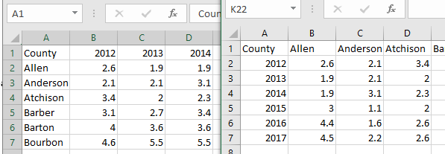

Data Preparation Part 1
Used Excel and R to wrangle and transform the data sets
Import Population CSV file unchanged to R, but transposed Crime data because it was easier in Excel (see snippet) then import to R

Slide 6
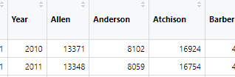
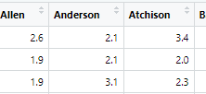
Data Preparation Part 2
After import of data sets in R, used pivot_wider on Population data to make it easier to compare with crime data (see snippets)
Other wangling actions to assist were on both datasets: remove unused columns, convert to data frame, assign row names, and only compare years in both data sets (2012 – 2017)
Used “data prep.R” script to complete all these actions

Slide 7
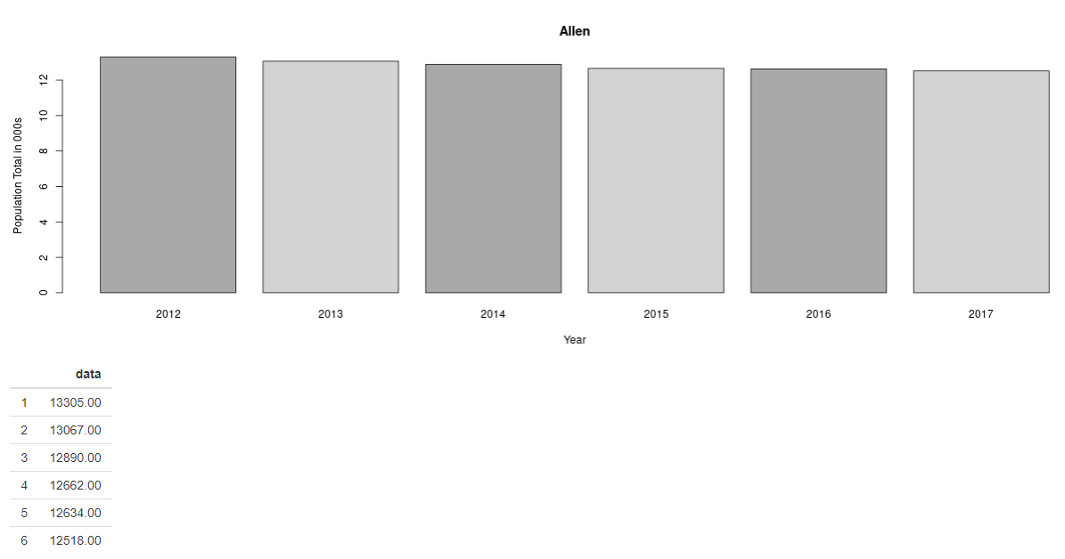
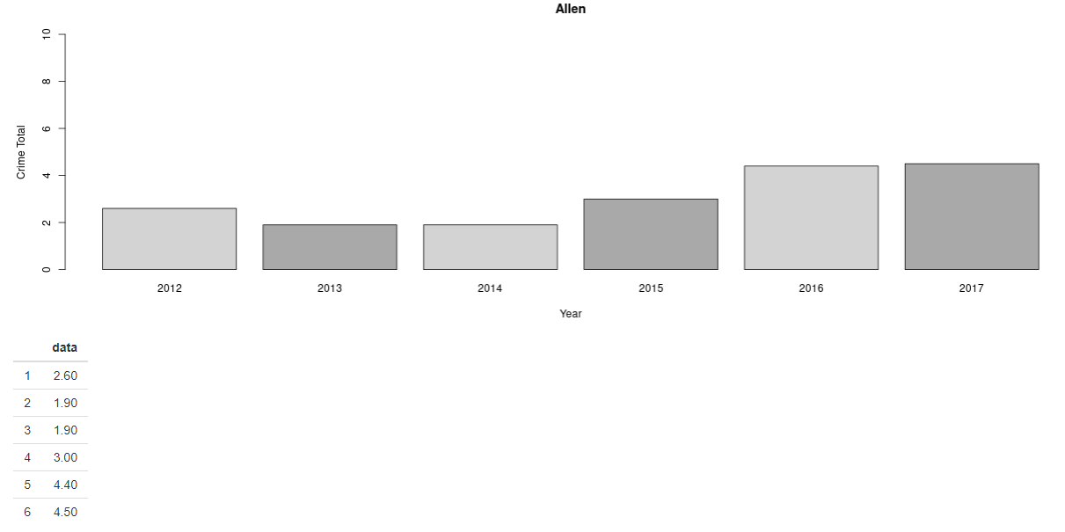
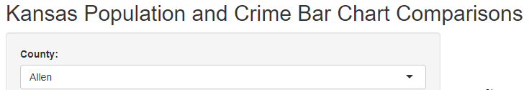
Data Visuals from Shiny App
Overview
Population Bar Plot and Table
Crime Bar Plot and Table
A user of the Shiny App could select a Kansas County (see snippet below) and see the population and crime rate for a six year period (2012 – 2017).
Bar plot and the data from the data sets are shown for the selected county.
Used alternating colors (light and dark gray) and sliding Y axis to adjust for small and large population counties.

Slide 8
Analysis and Insights
Changes in Population vs. Crime Rate
Crime increase, but population does not. Why?
Population increase, but not with crime increase. Why?
The Shiny App can easily show population increases, decreases, or little change. This is the same with crime rate.
Found that some counties did not change year to year, but others did. Either Population or Crime changed, both did, or neither.
Several counties would have crime increases, but not with population.
Assumption is that if you have less people, but same crime the rate will increase.
What else could cause this? Decrease police funding (tax base), employment loss, increase drug use, or something else.
Just like crime increase with population decrease, same with the opposite.
Assumption is that if you have more people, but same crime prevalence the rate will decrease.
What else could cause this? More police because increase tax base, more jobs for the populace, or better social programs.

Slide 9
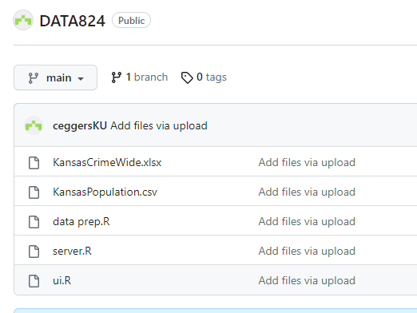
GitHub
ceggersKU/DATA824 (github.com)

Slide 10
Summary
Data Analysis using Shiny App
Further Actions
This Shiny App project can help stakeholders (Kansas Citizens, lawmakers, business investors and others) can find insights of each of Kansas Counties.
Population and their associated crime rate trends can assist stakeholders on how they want to move forward with a multitude of decisions.
With this data analysis, researchers can do predicative or further research the causes to the changes year to year.

Slide 11


THANK YOU
Charles Eggers
ceggers@kumc.edu
ceggersKU/DATA824 (github.com)

